Slide 1
Chapter 8: Normalization

Slide 2
Chapter 8: Normalization
Database normalization
Objectives
First normal form (1NF)
Second normal form (2NF)
Third normal form (3NF)
Decomposition Using Multivalued Dependencies
More Normal Form
Database-Design Process
Modeling Temporal Data

Slide 3
Database normalization
Database normalization, or simply normalization, is the process of restructuring a relational database in accordance with a series of so-called normal forms in order to reduce data redundancy and improve data integrity.
It was first proposed by Edgar F. Codd as an integral part of his relational model.(No connection to relationship set inst_dept)
The objectives of normalization beyond 1NF (first normal form) were stated as follows by Codd:
  To free the collection of relations from undesirable insertion, update and deletion dependencies;
  To reduce the need for restructuring the collection of relations, as new types of data are introduced, and thus increase the life span of application programs;
  To make the relational model more informative to users;
  To make the collection of relations neutral to the query statistics, where these statistics are liable to change as time goes by.

Slide 4
If not Normalized
When an attempt is made to modify (update, insert into, or delete from) a relation, the following undesirable side-effects may arise in relations that have not been sufficiently normalized:
Update anomaly
Insertion anomaly
Deletion anomaly

Slide 5
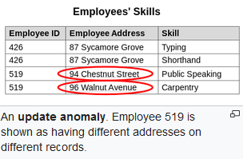
Update anomaly
Update anomaly: The same information can be expressed on multiple rows; therefore updates to the relation may result in logical inconsistencies. For example, each record in an "Employees' Skills" relation might contain an Employee ID, Employee Address, and Skill; thus a change of address for a particular employee may need to be applied to multiple records (one for each skill). If the update is only partially successful – the employee's address is updated on some records but not others – then the relation is left in an inconsistent state. Specifically, the relation provides conflicting answers to the question of what this particular employee's address is. This phenomenon is known as an update anomaly.

Slide 6
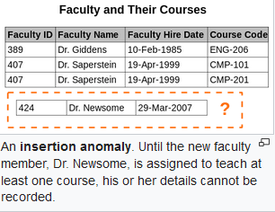
Insertion anomaly
Insertion anomaly: There are circumstances in which certain facts cannot be recorded at all. For example, each record in a "Faculty and Their Courses" relation might contain a Faculty ID, Faculty Name, Faculty Hire Date, and Course Code. Therefore, we can record the details of any faculty member who teaches at least one course, but we cannot record a newly hired faculty member who has not yet been assigned to teach any courses, except by setting the Course Code to null. This phenomenon is known as an insertion anomaly.

Slide 7
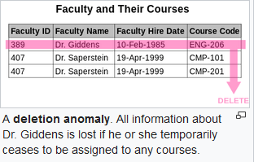
Deletion anomaly
Deletion anomaly: Under certain circumstances, deletion of data representing certain facts necessitates deletion of data representing completely different facts. A Delete Anomaly exists when certain attributes are lost because of the deletion of other attributes. For example, consider what happens if a faculty member leaves the course - All information about the course is lost.

Slide 8
First normal form (1NF)
First normal form (1NF) is a property of a relation in a relational database. A relation is in first normal form if and only if the domain of each attribute contains only atomic (indivisible) values, and the value of each attribute contains only a single value from that domain. The first definition of the term, in a 1971 conference paper by Edgar Codd, defined a relation to be in first normal form when none of its domains have any sets as elements.
First normal form is an essential property of a relation in a relational database. Database normalization is the process of representing a database in terms of relations in standard normal forms, where first normal is a minimal requirement.
First normal form enforces these criteria:
  Eliminate repeating groups in individual tables.
  Create a separate table for each set of related data.
  Identify each set of related data with a primary key

Slide 9
Atomicity
A domain is atomic if elements of the domain are considered to be indivisible units..
Composite attributes, such as an attribute address with component attributes street,city,state,and zip also have nonatomic domains..
Examples of such numbers would be
“CS001”and“EE1127”. Such identification numbers can be divided into smaller units, and are therefore nonatomic.
Hugh Darwen and Chris Date have suggested that Codd's concept of an "atomic value" is ambiguous, and that this ambiguity has led to widespread confusion about how 1NF should be understood.[8][9] In particular, the notion of a "value that cannot be decomposed" is problematic, as it would seem to imply that few, if any, data types are atomic:
A character string would seem not to be atomic, as the RDBMS typically provides operators to decompose it into substrings.
A fixed-point number would seem not to be atomic, as the RDBMS typically provides operators to decompose it into integer and fractional components.
An ISBN would seem not to be atomic, as it includes language and publisher identifier.
Date suggests that "the notion of atomicity has no absolute meaning":

Slide 10
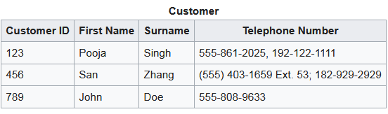
Designs that Violate 1NF
Below is a table that stores the names and telephone numbers of customers. One requirement though is to retain multiple telephone numbers for some customers. The simplest way of satisfying this requirement is to allow the "Telephone Number" column in any given row to contain more than one value:
Note that the telephone number column simply contains text: numbers of different formats, and more importantly, more than one number for two of the customers. We are duplicating related information in the same column. If we would be satisfied with such arbitrary text, we would be fine. But it's not arbitrary text at all: we obviously intended this column to contain telephone number(s). Seen as telephone numbers, the text is not atomic: it can be subdivided. As well, when seen as telephone numbers, the text contains more than one number in two of our rows. This representation of telephone numbers is not in first normal form: our columns contain non-atomic values, and they contain more than one of them.

Slide 11
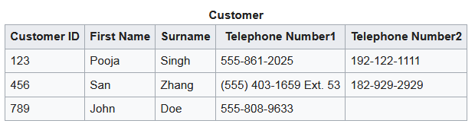
Designs that Violate 1NF
An apparent solution is to introduce more columns:
Technically, this table does not violate the requirement for values to be atomic. However, informally, the two telephone number columns still form a "repeating group": they repeat what is conceptually the same attribute, namely a telephone number. An arbitrary and hence meaningless ordering has been introduced: why is 555-861-2025 put into the Telephone Number1 column rather than the Telephone Number2 column? There's no reason why customers could not have more than two telephone numbers, so how many Telephone NumberN columns should there be? It is not possible to search for a telephone number without searching an arbitrary number of columns. Adding an extra telephone number may require the table to be reorganized by the addition of a new column rather than just having a new row (tuple) added. (The null value for Telephone Number2 for customer 789 is also an issue.)

Slide 12
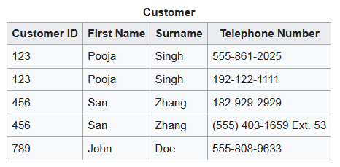
Designs that Comply with 1NF
To bring the model into the first normal form, we split the strings we used to hold our telephone number information into "atomic" (i.e. indivisible) entities: single phone numbers. And we ensure no row contains more than one phone number.

Slide 13

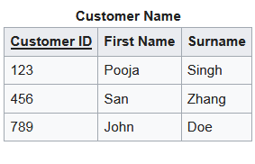
Designs that Comply with 1NF
Note that the "ID" is no longer unique in this solution with duplicated customers. To uniquely identify a row, we need to use a combination of (ID, Telephone Number). The value of the combination is unique although each column separately contains repeated values. Being able to uniquely identify a row (tuple) is a requirement of 1NF.
An alternative design uses two tables:

Slide 14
Second normal form (2NF)
Second normal form (2NF) is a normal form used in database normalization. 2NF was originally defined by E.F. Codd in 1971.[1]
A relation that is in first normal form (1NF) must meet additional criteria if it is to qualify for second normal form. Specifically: a relation is in 2NF if it is in 1NF and no non-prime attribute is dependent on any proper subset of any candidate key of the relation. A non-prime attribute of a relation is an attribute that is not a part of any candidate key of the relation.
Put simply, a relation is in 2NF if it is in 1NF and every non-prime attribute of the relation is dependent on the whole of every candidate key.

Slide 15
Functional dependency
Functional dependency is a relationship that exists when one attribute uniquely determines another attribute.
If R is a relation with attributes X and Y, a functional dependency between the attributes is represented as X->Y, which specifies Y is functionally dependent on X. Here X is a determinant set and Y is a dependent attribute.
Suppose one is designing a system to track vehicles and the capacity of their engines. Each vehicle has a unique vehicle identification number (VIN). One would write VIN → EngineCapacity because it would be inappropriate for a vehicle's engine to have more than one capacity. (Assuming, in this case, that vehicles only have one engine.) Transversely, EngineCapacity → VIN is incorrect because there could be many vehicles with the same engine capacity.
This functional dependency may suggest that the attribute EngineCapacity be placed in a relation with candidate key VIN. However, that may not always be appropriate. For example, if that functional dependency occurs as a result of the transitive functional dependencies VIN → VehicleModel and VehicleModel → EngineCapacity then that would not result in a normalized relation.

Slide 16
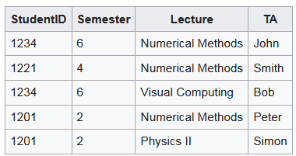
Functional dependency
Let's further assume that every student is in some semester and is identified by a unique integer ID.
We notice that whenever two rows in this table feature the same StudentID, they also necessarily have the same Semester values. This basic fact can be expressed by a functional dependency:
StudentID → Semester.
Note that if a row was added where the student had a different value of semester that the functional dependency, FD, would no longer exist. This means that the FD is implied by the data as it is possible to have values that would invalidate the FD.
Other nontrivial functional dependencies can be identified, for example:
{StudentID, Lecture} → TA
{StudentID, Lecture} → {TA, Semester}
The latter expresses the fact that the set {StudentID, Lecture} is a superkey of the relation.

Slide 17
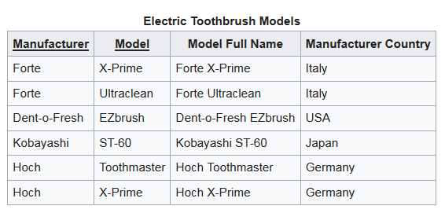
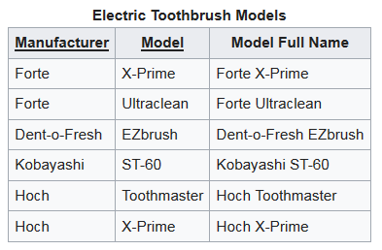
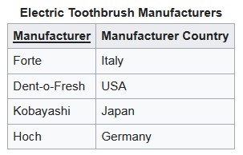
Second normal form (2NF)
Even if the designer has specified the primary key as {Model Full Name}, the relation is not in 2NF because of the other candidate keys. {Manufacturer, Model} is also a candidate key, and Manufacturer Country is dependent on a proper subset of it: Manufacturer. To make the design conform to 2NF, it is necessary to have two relations:

Slide 18
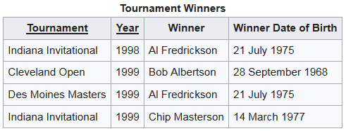
Third normal form (3NF)
Third normal form (3NF) is a normal form that is used in normalizing a database design to reduce the duplication of data and ensure referential integrity by ensuring that (1) the entity is in second normal form, and (2) all the attributes in a table are determined only by the candidate keys of that relation and not by any non-prime attributes. 3NF was designed to improve database processing while minimizing storage costs.
An example of a 2NF table that fails to meet the requirements of 3NF is:

Slide 19
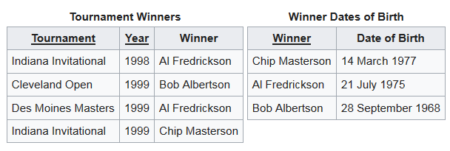
Third normal form (3NF)
Because each row in the table needs to tell us who won a particular Tournament in a particular Year, the composite key {Tournament, Year} is a minimal set of attributes guaranteed to uniquely identify a row. That is, {Tournament, Year} is a candidate key for the table.
The breach of 3NF occurs because the non-prime attribute Winner Date of Birth is transitively dependent on the candidate key {Tournament, Year} via the non-prime attribute Winner. The fact that Winner Date of Birth is functionally dependent on Winner makes the table vulnerable to logical inconsistencies, as there is nothing to stop the same person from being shown with different dates of birth on different records.
In order to express the same facts without violating 3NF, it is necessary to split the table into two:
Update anomalies cannot occur in these tables, because unlike before, Winner is now a primary key in the second table, thus allowing only one value for Date of Birth for each Winner.

Slide 20
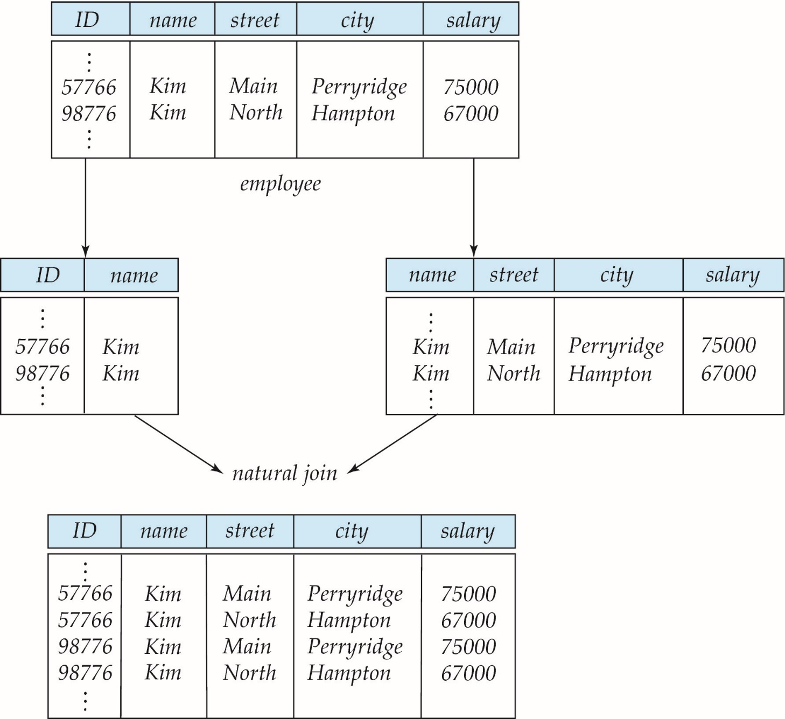
A Lossy Decomposition (No Included from this slide)

Slide 21
Example of Lossless-Join Decomposition
Lossless join decomposition
Decomposition of R = (A, B, C)
R₁ = (A, B) R₂ = (B, C)
A
B
C
A
B
B
C
α
β
1
2
A
B
α
β
1
2
1
2
A
B
r
∏_{A,B}(r)
∏_{B,C}(r)
∏_{A} (r) ∏_{B} (r)
A
B
C
α
β
1
2
A
B

Slide 22
First Normal Form
Domain is atomic if its elements are considered to be indivisible units
  Examples of non-atomic domains:
    Set of names, composite attributes
    Identification numbers like CS101 that can be broken up into parts
A relational schema R is in first normal form if the domains of all attributes of R are atomic
Non-atomic values complicate storage and encourage redundant (repeated) storage of data
  Example: Set of accounts stored with each customer, and set of owners stored with each account
  We assume all relations are in first normal form (and revisit this in Chapter 22: Object Based Databases)

Slide 23
First Normal Form (Cont’d)
Atomicity is actually a property of how the elements of the domain are used.
  Example: Strings would normally be considered indivisible
  Suppose that students are given roll numbers which are strings of the form CS0012 or EE1127
  If the first two characters are extracted to find the department, the domain of roll numbers is not atomic.
  Doing so is a bad idea: leads to encoding of information in application program rather than in the database.

Slide 24
Goal — Devise a Theory for the Following
Decide whether a particular relation R is in “good” form.
In the case that a relation R is not in “good” form, decompose it into a set of relations {R₁, R₂, ..., R_{n}} such that
  each relation is in good form
  the decomposition is a lossless-join decomposition
Our theory is based on:
  functional dependencies
  multivalued dependencies

Slide 25
Functional Dependencies
Constraints on the set of legal relations.
Require that the value for a certain set of attributes determines uniquely the value for another set of attributes.
A functional dependency is a generalization of the notion of a key.

Slide 26
Functional Dependencies (Cont.)
Let R be a relation schema
α ⊆ R and β ⊆ R
The functional dependency
α → β
holds on R if and only if for any legal relations r(R), whenever any two tuples t₁ and t₂ of r agree on the attributes α, they also agree on the attributes β. That is,
t₁[α] = t₂ [α] ⇒ t₁[β ] = t₂ [β ]
Example: Consider r(A,B ) with the following instance of r.
On this instance, A → B does NOT hold, but B → A does hold.
4
1 5
3 7

Slide 27
Functional Dependencies (Cont.)
K is a superkey for relation schema R if and only if K → R
K is a candidate key for R if and only if
  K → R, and
  for no α ⊂ K, α → R
Functional dependencies allow us to express constraints that cannot be expressed using superkeys. Consider the schema:
inst_dept (ID, name, salary, dept_name, building, budget ).
We expect these functional dependencies to hold:
dept_name→ building
and ID → building
but would not expect the following to hold:
dept_name → salary

Slide 28
Use of Functional Dependencies
We use functional dependencies to:
  test relations to see if they are legal under a given set of functional dependencies.
    If a relation r is legal under a set F of functional dependencies, we say that r satisfies F.
  specify constraints on the set of legal relations
    We say that F holds on R if all legal relations on R satisfy the set of functional dependencies F.
Note: A specific instance of a relation schema may satisfy a functional dependency even if the functional dependency does not hold on all legal instances.
  For example, a specific instance of instructor may, by chance, satisfy
  name → ID.

Slide 29
Functional Dependencies (Cont.)
A functional dependency is trivial if it is satisfied by all instances of a relation
  Example:
    ID, name → ID
    name → name
  In general, α → β is trivial if β ⊆ α

Slide 30
Closure of a Set of Functional Dependencies
Given a set F of functional dependencies, there are certain other functional dependencies that are logically implied by F.
  For example: If A → B and B → C, then we can infer that A → C
The set of all functional dependencies logically implied by F is the closure of F.
We denote the closure of F by F⁺.
F⁺ is a superset of F.

Slide 31
Boyce-Codd Normal Form
A relation schema R is in BCNF with respect to a set F of functional dependencies if for all functional dependencies in F⁺ of the form
α → β
where α ⊆ R and β ⊆ R, at least one of the following holds:
α  → β is trivial (i.e., β ⊆ α)
α is a superkey for R
Example schema not in BCNF:
instr_dept (ID, name, salary, dept_name, building, budget )
because dept_name→ building, budget
holds on instr_dept, but dept_name is not a superkey

Slide 32
Decomposing a Schema into BCNF
Suppose we have a schema R and a non-trivial dependency α →β causes a violation of BCNF.
We decompose R into:
  (α U β )
  ( R - ( β - α ) )
In our example,
  α = dept_name
  β = building, budget
  and inst_dept is replaced by
  (α U β ) = ( dept_name, building, budget )
  ( R - ( β - α ) ) = ( ID, name, salary, dept_name )

Slide 33
BCNF and Dependency Preservation
Constraints, including functional dependencies, are costly to check in practice unless they pertain to only one relation
If it is sufficient to test only those dependencies on each individual relation of a decomposition in order to ensure that all functional dependencies hold, then that decomposition is dependency preserving.
Because it is not always possible to achieve both BCNF and dependency preservation, we consider a weaker normal form, known as third normal form.

Slide 34
Third Normal Form
A relation schema R is in third normal form (3NF) if for all:
α → β in F⁺
at least one of the following holds:
  α → β is trivial (i.e., β ∈ α)
  α is a superkey for R
  Each attribute A in β – α is contained in a candidate key for R.
  (NOTE: each attribute may be in a different candidate key)
If a relation is in BCNF it is in 3NF (since in BCNF one of the first two conditions above must hold).
Third condition is a minimal relaxation of BCNF to ensure dependency preservation (will see why later).

Slide 35
Goals of Normalization
Let R be a relation scheme with a set F of functional dependencies.
Decide whether a relation scheme R is in “good” form.
In the case that a relation scheme R is not in “good” form, decompose it into a set of relation scheme {R₁, R₂, ..., R_{n}} such that
  each relation scheme is in good form
  the decomposition is a lossless-join decomposition
  Preferably, the decomposition should be dependency preserving.

Slide 36
How good is BCNF?
There are database schemas in BCNF that do not seem to be sufficiently normalized
Consider a relation
inst_info (ID, child_name, phone)
  where an instructor may have more than one phone and can have multiple children
ID
child_name
phone
99999
99999
99999
99999
David
David
William
Willian
512-555-1234
512-555-4321
512-555-1234
512-555-4321
inst_info

Slide 37
How good is BCNF? (Cont.)
There are no non-trivial functional dependencies and therefore the relation is in BCNF
Insertion anomalies – i.e., if we add a phone 981-992-3443 to 99999, we need to add two tuples
(99999, David, 981-992-3443)
(99999, William, 981-992-3443)

Slide 38
How good is BCNF? (Cont.)
Therefore, it is better to decompose inst_info into:
ID
child_name
inst_child
99999
99999
99999
99999
David
David
William
Willian
ID
phone
inst_phone
99999
99999
99999
99999
512-555-1234
512-555-4321
512-555-1234
512-555-4321
This suggests the need for higher normal forms, such as Fourth Normal Form (4NF), which we shall see later.

Slide 39
Functional-Dependency Theory
We now consider the formal theory that tells us which functional dependencies are implied logically by a given set of functional dependencies.
We then develop algorithms to generate lossless decompositions into BCNF and 3NF
We then develop algorithms to test if a decomposition is dependency-preserving

Slide 40
Closure of a Set of Functional Dependencies
Given a set F set of functional dependencies, there are certain other functional dependencies that are logically implied by F.
  For e.g.: If A → B and B → C, then we can infer that A → C
The set of all functional dependencies logically implied by F is the closure of F.
We denote the closure of F by F⁺.

Slide 41
Closure of a Set of Functional Dependencies
We can find F^{+,} the closure of F, by repeatedly applying
Armstrong’s Axioms:
  if β ⊆ α, then α → β (reflexivity)
  if α → β, then γ α → γ β (augmentation)
  if α → β, and β → γ, then α → γ (transitivity)
These rules are
  sound (generate only functional dependencies that actually hold), and
  complete (generate all functional dependencies that hold).

Slide 42
Example
R = (A, B, C, G, H, I)
F = { A → B
A → C
CG → H
CG → I
B → H}
some members of F⁺
  A → H
    by transitivity from A → B and B → H
  AG → I
    by augmenting A → C with G, to get AG → CG
    and then transitivity with CG → I
  CG → HI
    by augmenting CG → I to infer CG → CGI,
    and augmenting of CG → H to infer CGI → HI,
    and then transitivity

Slide 43
Procedure for Computing F⁺
To compute the closure of a set of functional dependencies F:
F ⁺ = F
repeat
for each functional dependency f in F⁺
apply reflexivity and augmentation rules on f
add the resulting functional dependencies to F ⁺
for each pair of functional dependencies f₁and f₂ in F ⁺
if f₁ and f₂ can be combined using transitivity
then add the resulting functional dependency to F ⁺
until F ⁺ does not change any further
NOTE: We shall see an alternative procedure for this task later

Slide 44
Closure of Functional Dependencies (Cont.)
Additional rules:
  If α → β holds and α → γ holds, then α → β γ holds (union)
  If α → β γ holds, then α → β holds and α → γ holds (decomposition)
  If α → β holds and γ β → δ holds, then α γ → δ holds (pseudotransitivity)
  The above rules can be inferred from Armstrong’s axioms.

Slide 45
Closure of Attribute Sets
Given a set of attributes α, define the closure of α under F (denoted by α⁺) as the set of attributes that are functionally determined by α under F
Algorithm to compute α⁺, the closure of α under F
result := α;
while (changes to result) do
for each β → γ in F do
begin
if β ⊆ result then result := result ∪ γ
end

Slide 46
Example of Attribute Set Closure
R = (A, B, C, G, H, I)
F = {A → B
A → C
CG → H
CG → I
B → H}
(AG)⁺
  1. result = AG
  2. result = ABCG (A → C and A → B)
  3. result = ABCGH (CG → H and CG ⊆ AGBC)
  4. result = ABCGHI (CG → I and CG ⊆ AGBCH)
Is AG a candidate key?
  Is AG a super key?
    Does AG → R? == Is (AG)⁺ ⊇ R
  Is any subset of AG a superkey?
    Does A → R? == Is (A)⁺ ⊇ R
    Does G → R? == Is (G)⁺ ⊇ R

Slide 47
Uses of Attribute Closure
There are several uses of the attribute closure algorithm:
Testing for superkey:
  To test if α is a superkey, we compute α^{+,} and check if α⁺ contains all attributes of R.
Testing functional dependencies
  To check if a functional dependency α → β holds (or, in other words, is in F⁺), just check if β ⊆ α⁺.
  That is, we compute α⁺ by using attribute closure, and then check if it contains β.
  Is a simple and cheap test, and very useful
Computing closure of F
  For each γ ⊆ R, we find the closure γ⁺, and for each S ⊆ γ⁺, we output a functional dependency γ → S.

Slide 48
Canonical Cover
Sets of functional dependencies may have redundant dependencies that can be inferred from the others
  For example: A → C is redundant in: {A → B, B → C, A→ C}
  Parts of a functional dependency may be redundant
    E.g.: on RHS: {A → B, B → C, A → CD} can be simplified to
    {A → B, B → C, A → D}
    E.g.: on LHS: {A → B, B → C, AC → D} can be simplified to
    {A → B, B → C, A → D}
Intuitively, a canonical cover of F is a “minimal” set of functional dependencies equivalent to F, having no redundant dependencies or redundant parts of dependencies

Slide 49
Extraneous Attributes
Consider a set F of functional dependencies and the functional dependency α → β in F.
  Attribute A is extraneous in α if A ∈ α
  and F logically implies (F – {α → β}) ∪ {(α – A) → β}.
  Attribute A is extraneous in β if A ∈ β
  and the set of functional dependencies
  (F – {α → β}) ∪ {α →(β – A)} logically implies F.
Note: implication in the opposite direction is trivial in each of the cases above, since a “stronger” functional dependency always implies a weaker one
Example: Given F = {A → C, AB → C }
  B is extraneous in AB → C because {A → C, AB → C} logically implies A → C (I.e. the result of dropping B from AB → C).
Example: Given F = {A → C, AB → CD}
  C is extraneous in AB → CD since AB → C can be inferred even after deleting C

Slide 50
Testing if an Attribute is Extraneous
Consider a set F of functional dependencies and the functional dependency α → β in F.
To test if attribute A ∈ α is extraneous in α
  compute ({α} – A)⁺ using the dependencies in F
  check that ({α} – A)⁺ contains β; if it does, A is extraneous in α
To test if attribute A ∈ β is extraneous in β
  compute α⁺ using only the dependencies in
  F’ = (F – {α → β}) ∪ {α →(β – A)},
  check that α⁺ contains A; if it does, A is extraneous in β

Slide 51
Canonical Cover
A canonical cover for F is a set of dependencies F_{c} such that
  F logically implies all dependencies in F_{c,} and
  F_{c} logically implies all dependencies in F, and
  No functional dependency in F_{c} contains an extraneous attribute, and
  Each left side of functional dependency in F_{c} is unique.
To compute a canonical cover for F:
repeat
Use the union rule to replace any dependencies in F
α₁ → β₁ and α₁ → β₂ with α₁ → β₁ β₂
Find a functional dependency α → β with an
extraneous attribute either in α or in β
/* Note: test for extraneous attributes done using F_{c,} not F*/
If an extraneous attribute is found, delete it from α → β
until F does not change
Note: Union rule may become applicable after some extraneous attributes have been deleted, so it has to be re-applied

Slide 52
Computing a Canonical Cover
R = (A, B, C)
F = {A → BC
B → C
A → B
AB → C}
Combine A → BC and A → B into A → BC
  Set is now {A → BC, B → C, AB → C}
A is extraneous in AB → C
  Check if the result of deleting A from AB → C is implied by the other dependencies
    Yes: in fact, B → C is already present!
  Set is now {A → BC, B → C}
C is extraneous in A → BC
  Check if A → C is logically implied by A → B and the other dependencies
    Yes: using transitivity on A → B and B → C.
      Can use attribute closure of A in more complex cases
The canonical cover is: A → B
B → C

Slide 53
Lossless-join Decomposition
For the case of R = (R₁, R₂), we require that for all possible relations r on schema R
r = ∏_{R1} (r ) ∏_{R2} (r )
A decomposition of R into R₁ and R₂ is lossless join if at least one of the following dependencies is in F⁺:
  R₁ ∩ R₂ → R₁
  R₁ ∩ R₂ → R₂
The above functional dependencies are a sufficient condition for lossless join decomposition; the dependencies are a necessary condition only if all constraints are functional dependencies

Slide 54

Example
R = (A, B, C)
F = {A → B, B → C)
  Can be decomposed in two different ways
R₁ = (A, B), R₂ = (B, C)
  Lossless-join decomposition:
  R₁ ∩ R₂ = {B} and B → BC
  Dependency preserving
R₁ = (A, B), R₂ = (A, C)
  Lossless-join decomposition:
  R₁ ∩ R₂ = {A} and A → AB
  Not dependency preserving
  (cannot check B → C without computing R₁ R₂)

Slide 55
Dependency Preservation
Let F_{i} be the set of dependencies F ⁺ that include only attributes in R_{i}.
    A decomposition is dependency preserving, if
    (F₁ ∪ F₂ ∪ … ∪ F_{n} )⁺ = F ⁺
    If it is not, then checking updates for violation of functional dependencies may require computing joins, which is expensive.

Slide 56
Testing for Dependency Preservation
To check if a dependency α → β is preserved in a decomposition of R into R₁, R₂, …, R_{n} we apply the following test (with attribute closure done with respect to F)
  result = α
  while (changes to result) do
  for each R_{i} in the decomposition
  t = (result ∩ R_{i})⁺ ∩ R_{i}
  result = result ∪ t
  If result contains all attributes in β, then the functional dependency
  α → β is preserved.
We apply the test on all dependencies in F to check if a decomposition is dependency preserving
This procedure takes polynomial time, instead of the exponential time required to compute F⁺ and (F₁ ∪ F₂ ∪ … ∪ F_{n})⁺

Slide 57
Example
R = (A, B, C )
F = {A → B
B → C}
Key = {A}
R is not in BCNF
Decomposition R₁ = (A, B), R₂ = (B, C)
  R₁ and R₂ in BCNF
  Lossless-join decomposition
  Dependency preserving

Slide 58
Testing for BCNF
To check if a non-trivial dependency α →β causes a violation of BCNF
  1. compute α⁺ (the attribute closure of α), and
  2. verify that it includes all attributes of R, that is, it is a superkey of R.
Simplified test: To check if a relation schema R is in BCNF, it suffices to check only the dependencies in the given set F for violation of BCNF, rather than checking all dependencies in F⁺.
  If none of the dependencies in F causes a violation of BCNF, then none of the dependencies in F⁺ will cause a violation of BCNF either.
However, simplified test using only F is incorrect when testing a relation in a decomposition of R
  Consider R = (A, B, C, D, E), with F = { A → B, BC → D}
    Decompose R into R₁ = (A,B) and R₂ = (A,C,D, E)
    Neither of the dependencies in F contain only attributes from
    (A,C,D,E) so we might be mislead into thinking R₂ satisfies BCNF.
    In fact, dependency AC → D in F⁺ shows R₂ is not in BCNF.

Slide 59
Testing Decomposition for BCNF
To check if a relation R_{i} in a decomposition of R is in BCNF,
  Either test R_{i} for BCNF with respect to the restriction of F to R_{i} (that is, all FDs in F⁺ that contain only attributes from R_{i})
  or use the original set of dependencies F that hold on R, but with the following test:
      for every set of attributes α ⊆ R_{i}, check that α⁺ (the attribute closure of α) either includes no attribute of R_{i}- α, or includes all attributes of R_{i}.
    If the condition is violated by some α → β in F, the dependency
    α → (α⁺ - α ) ∩ R_{i}
    can be shown to hold on R_{i}, and R_{i} violates BCNF.
    We use above dependency to decompose R_{i}

Slide 60
BCNF Decomposition Algorithm
result := {R };
done := false;
compute F ⁺;
while (not done) do
if (there is a schema R_{i} in result that is not in BCNF)
then begin
let α  → β be a nontrivial functional dependency that
holds on R_{i} such that α  → R_{i} is not in F ⁺,
and α ∩ β = ∅;
result := (result – R_{i} ) ∪ (R_{i} – β) ∪ (α, β );
end
else done := true;
Note: each R_{i} is in BCNF, and decomposition is lossless-join.

Slide 61
Example of BCNF Decomposition
R = (A, B, C )
F = {A → B
B → C}
Key = {A}
R is not in BCNF (B → C but B is not superkey)
Decomposition
  R₁ = (B, C)
  R₂ = (A,B)

Slide 62
Example of BCNF Decomposition
class (course_id, title, dept_name, credits, sec_id, semester, year, building, room_number, capacity, time_slot_id)
Functional dependencies:
  course_id→ title, dept_name, credits
  building, room_number→capacity
  course_id, sec_id, semester, year→building, room_number, time_slot_id
A candidate key {course_id, sec_id, semester, year}.
BCNF Decomposition:
  course_id→ title, dept_name, credits holds
    but course_id is not a superkey.
  We replace class by:
    course(course_id, title, dept_name, credits)
    class-1 (course_id, sec_id, semester, year, building,
    room_number, capacity, time_slot_id)

Slide 63
BCNF Decomposition (Cont.)
course is in BCNF
  How do we know this?
building, room_number→capacity holds on class-1
  but {building, room_number} is not a superkey for class-1.
  We replace class-1 by:
    classroom (building, room_number, capacity)
    section (course_id, sec_id, semester, year, building, room_number, time_slot_id)
classroom and section are in BCNF.

Slide 64
BCNF and Dependency Preservation
It is not always possible to get a BCNF decomposition that is
dependency preserving
R = (J, K, L )
F = {JK → L
L → K }
Two candidate keys = JK and JL
R is not in BCNF
Any decomposition of R will fail to preserve
JK → L
This implies that testing for JK → L requires a join

Slide 65
Third Normal Form: Motivation
There are some situations where
  BCNF is not dependency preserving, and
  efficient checking for FD violation on updates is important
Solution: define a weaker normal form, called Third Normal Form (3NF)
  Allows some redundancy (with resultant problems; we will see examples later)
  But functional dependencies can be checked on individual relations without computing a join.
  There is always a lossless-join, dependency-preserving decomposition into 3NF.

Slide 66
3NF Example
Relation dept_advisor:
  dept_advisor (s_ID, i_ID, dept_name)
  F = {s_ID, dept_name → i_ID, i_ID → dept_name}
  Two candidate keys: s_ID, dept_name, and i_ID, s_ID
  R is in 3NF
    s_ID, dept_name → i_ID s_ID
      dept_name is a superkey
    i_ID → dept_name
      dept_name is contained in a candidate key

Slide 67
Redundancy in 3NF
There is some redundancy in this schema
Example of problems due to redundancy in 3NF
  R = (J, K, L)
  F = {JK → L, L → K }
J
L
K
j₁
j₂
j₃
null
l₁
l₁
l₁
l₂
k₁
k₁
k₁
k₂
repetition of information (e.g., the relationship l₁, k₁)
  (i_ID, dept_name)
need to use null values (e.g., to represent the relationship
l₂, k₂ where there is no corresponding value for J).
  (i_ID, dept_nameI) if there is no separate relation mapping instructors to departments

Slide 68
Testing for 3NF
Optimization: Need to check only FDs in F, need not check all FDs in F⁺.
Use attribute closure to check for each dependency α → β, if α is a superkey.
If α is not a superkey, we have to verify if each attribute in β is contained in a candidate key of R
  this test is rather more expensive, since it involve finding candidate keys
  testing for 3NF has been shown to be NP-hard
  Interestingly, decomposition into third normal form (described shortly) can be done in polynomial time

Slide 69
3NF Decomposition Algorithm
Let F_{c} be a canonical cover for F;
i := 0;
for each functional dependency α → β in F_{c} do
if none of the schemas R_{j}, 1 ≤ j ≤ i contains α β
then begin
i := i + 1;
R_{i} := α β
end
if none of the schemas R_{j}, 1 ≤ j ≤ i contains a candidate key for R
then begin
i := i + 1;
R_{i} := any candidate key for R;
end
/* Optionally, remove redundant relations */
repeat
if any schema R_{j} is contained in another schema R_{k}
then /* delete R_{j} */
R_{j} = R;;
i=i-1;
return (R₁, R₂, ..., R_{i})

Slide 70
3NF Decomposition Algorithm (Cont.)
Above algorithm ensures:
  each relation schema R_{i} is in 3NF
  decomposition is dependency preserving and lossless-join
  Proof of correctness is at end of this presentation (click here)

Slide 71
3NF Decomposition: An Example
Relation schema:
  cust_banker_branch = (customer_id, employee_id, branch_name, type )
The functional dependencies for this relation schema are:
  customer_id, employee_id → branch_name, type
  employee_id → branch_name
  customer_id, branch_name → employee_id
We first compute a canonical cover
  branch_name is extraneous in the r.h.s. of the 1st dependency
  No other attribute is extraneous, so we get F_{C} =
  customer_id, employee_id → type
  employee_id → branch_name
  customer_id, branch_name → employee_id

Slide 72
3NF Decompsition Example (Cont.)
The for loop generates following 3NF schema:
(customer_id, employee_id, type )
(employee_id, branch_name)
(customer_id, branch_name, employee_id)
  Observe that (customer_id, employee_id, type ) contains a candidate key of the original schema, so no further relation schema needs be added
At end of for loop, detect and delete schemas, such as (employee_id, branch_name), which are subsets of other schemas
  result will not depend on the order in which FDs are considered
The resultant simplified 3NF schema is:
(customer_id, employee_id, type)
(customer_id, branch_name, employee_id)

Slide 73
Comparison of BCNF and 3NF
It is always possible to decompose a relation into a set of relations that are in 3NF such that:
  the decomposition is lossless
  the dependencies are preserved
It is always possible to decompose a relation into a set of relations that are in BCNF such that:
  the decomposition is lossless
  it may not be possible to preserve dependencies.

Slide 74
Design Goals
Goal for a relational database design is:
  BCNF.
  Lossless join.
  Dependency preservation.
If we cannot achieve this, we accept one of
  Lack of dependency preservation
  Redundancy due to use of 3NF
Interestingly, SQL does not provide a direct way of specifying functional dependencies other than superkeys.
Can specify FDs using assertions, but they are expensive to test, (and currently not supported by any of the widely used databases!)
Even if we had a dependency preserving decomposition, using SQL we would not be able to efficiently test a functional dependency whose left hand side is not a key.

Slide 75
Multivalued Dependencies
Suppose we record names of children, and phone numbers for instructors:
  inst_child(ID, child_name)
  inst_phone(ID, phone_number)
If we were to combine these schemas to get
  inst_info(ID, child_name, phone_number)
  Example data:
  (99999, David, 512-555-1234)
  (99999, David, 512-555-4321)
  (99999, William, 512-555-1234)
  (99999, William, 512-555-4321)
This relation is in BCNF
  Why?

Slide 76
Multivalued Dependencies (MVDs)
Let R be a relation schema and let α ⊆ R and β ⊆ R. The multivalued dependency
α →→ β
holds on R if in any legal relation r(R), for all pairs for tuples t₁ and t₂ in r such that t₁[α] = t₂ [α], there exist tuples t₃ and t₄ in r such that:
t₁[α] = t₂ [α] = t₃ [α] = t₄ [α]
t₃[β] = t₁ [β]
t₃[R – β] = t₂[R – β]
t₄ [β] = t₂[β]
t₄[R – β] = t₁[R – β]

Slide 77

MVD (Cont.)
Tabular representation of α →→ β

Slide 78
Example
Let R be a relation schema with a set of attributes that are partitioned into 3 nonempty subsets.
Y, Z, W
We say that Y →→ Z (Y multidetermines Z )
if and only if for all possible relations r (R )
< y₁, z₁, w₁ > ∈ r and < y₁, z₂, w₂ > ∈ r
then
< y₁, z₁, w₂ > ∈ r and < y₁, z₂, w₁ > ∈ r
Note that since the behavior of Z and W are identical it follows that
Y →→ Z if Y →→ W

Slide 79
Example (Cont.)
In our example:
ID →→ child_name
ID →→ phone_number
The above formal definition is supposed to formalize the notion that given a particular value of Y (ID) it has associated with it a set of values of Z (child_name) and a set of values of W (phone_number), and these two sets are in some sense independent of each other.
Note:
  If Y → Z then Y →→ Z
  Indeed we have (in above notation) Z₁ = Z₂
  The claim follows.

Slide 80
Use of Multivalued Dependencies
We use multivalued dependencies in two ways:
  1. To test relations to determine whether they are legal under a given set of functional and multivalued dependencies
  2. To specify constraints on the set of legal relations. We shall thus concern ourselves only with relations that satisfy a given set of functional and multivalued dependencies.
If a relation r fails to satisfy a given multivalued dependency, we can construct a relations r′ that does satisfy the multivalued dependency by adding tuples to r.

Slide 81
Theory of MVDs
From the definition of multivalued dependency, we can derive the following rule:
  If α → β, then α →→ β
That is, every functional dependency is also a multivalued dependency
The closure D⁺ of D is the set of all functional and multivalued dependencies logically implied by D.
  We can compute D⁺ from D, using the formal definitions of functional dependencies and multivalued dependencies.
  We can manage with such reasoning for very simple multivalued dependencies, which seem to be most common in practice
  For complex dependencies, it is better to reason about sets of dependencies using a system of inference rules (see Appendix C).

Slide 82
Fourth Normal Form
A relation schema R is in 4NF with respect to a set D of functional and multivalued dependencies if for all multivalued dependencies in D⁺ of the form α →→ β, where α ⊆ R and β ⊆ R, at least one of the following hold:
  α →→ β is trivial (i.e., β ⊆ α or α ∪ β = R)
  α is a superkey for schema R
If a relation is in 4NF it is in BCNF

Slide 83
Restriction of Multivalued Dependencies
The restriction of D to R_{i} is the set D_{i} consisting of
  All functional dependencies in D⁺ that include only attributes of R_{i}
  All multivalued dependencies of the form
    α →→ (β ∩ R_{i})
  where α ⊆ R_{i} and α →→ β is in D⁺

Slide 84
4NF Decomposition Algorithm
result: = {R};
done := false;
compute D⁺;
Let D_{i} denote the restriction of D⁺ to R_{i}
while (not done)
if (there is a schema R_{i} in result that is not in 4NF) then
begin
let α →→ β be a nontrivial multivalued dependency that holds
on R_{i} such that α → R_{i} is not in D_{i}, and α∩β=φ;
result := (result - R_{i}) ∪ (R_{i} - β) ∪ (α, β);
end
else done:= true;
Note: each R_{i} is in 4NF, and decomposition is lossless-join

Slide 85
Example
R =(A, B, C, G, H, I)
F ={ A →→ B
B →→ HI
CG →→ H }
R is not in 4NF since A →→ B and A is not a superkey for R
Decomposition
a) R₁ = (A, B) (R₁ is in 4NF)
b) R₂ = (A, C, G, H, I) (R₂ is not in 4NF, decompose into R₃ and R₄)
c) R₃ = (C, G, H) (R₃ is in 4NF)
d) R₄ = (A, C, G, I) (R₄ is not in 4NF, decompose into R₅ and R₆)
  A →→ B and B →→ HI ➔ A →→ HI, (MVD transitivity), and
  and hence A →→ I (MVD restriction to R₄)
e) R₅ = (A, I) (R₅ is in 4NF)
f)R₆ = (A, C, G) (R₆ is in 4NF)

Slide 86
Further Normal Forms
Join dependencies generalize multivalued dependencies
  lead to project-join normal form (PJNF) (also called fifth normal form)
A class of even more general constraints, leads to a normal form called domain-key normal form.
Problem with these generalized constraints: are hard to reason with, and no set of sound and complete set of inference rules exists.
Hence rarely used

Slide 87
Overall Database Design Process
We have assumed schema R is given
  R could have been generated when converting E-R diagram to a set of tables.
  R could have been a single relation containing all attributes that are of interest (called universal relation).
  Normalization breaks R into smaller relations.
  R could have been the result of some ad hoc design of relations, which we then test/convert to normal form.

Slide 88
ER Model and Normalization
When an E-R diagram is carefully designed, identifying all entities correctly, the tables generated from the E-R diagram should not need further normalization.
However, in a real (imperfect) design, there can be functional dependencies from non-key attributes of an entity to other attributes of the entity
  Example: an employee entity with attributes
  department_name and building,
  and a functional dependency
  department_name→ building
  Good design would have made department an entity
Functional dependencies from non-key attributes of a relationship set possible, but rare --- most relationships are binary

Slide 89
Denormalization for Performance
May want to use non-normalized schema for performance
For example, displaying prereqs along with course_id, and title requires join of course with prereq
Alternative 1: Use denormalized relation containing attributes of course as well as prereq with all above attributes
  faster lookup
  extra space and extra execution time for updates
  extra coding work for programmer and possibility of error in extra code
Alternative 2: use a materialized view defined as
course prereq
  Benefits and drawbacks same as above, except no extra coding work for programmer and avoids possible errors

Slide 90
Other Design Issues
Some aspects of database design are not caught by normalization
Examples of bad database design, to be avoided:
Instead of earnings (company_id, year, amount ), use
  earnings_2004, earnings_2005, earnings_2006, etc., all on the schema (company_id, earnings).
    Above are in BCNF, but make querying across years difficult and needs new table each year
  company_year (company_id, earnings_2004, earnings_2005,
  earnings_2006)
    Also in BCNF, but also makes querying across years difficult and requires new attribute each year.
    Is an example of a crosstab, where values for one attribute become column names
    Used in spreadsheets, and in data analysis tools

Slide 91
Modeling Temporal Data
Temporal data have an association time interval during which the data are valid.
A snapshot is the value of the data at a particular point in time
Several proposals to extend ER model by adding valid time to
  attributes, e.g., address of an instructor at different points in time
  entities, e.g., time duration when a student entity exists
  relationships, e.g., time during which an instructor was associated with a student as an advisor.
But no accepted standard
Adding a temporal component results in functional dependencies like
ID → street, city
not to hold, because the address varies over time
A temporal functional dependency X → Y holds on schema R if the functional dependency X → Y holds on all snapshots for all legal instances r (R).
⧫

Slide 92
Modeling Temporal Data (Cont.)
In practice, database designers may add start and end time attributes to relations
  E.g., course(course_id, course_title) is replaced by
    course(course_id, course_title, start, end)
    Constraint: no two tuples can have overlapping valid times
      Hard to enforce efficiently
Foreign key references may be to current version of data, or to data at a point in time
  E.g., student transcript should refer to course information at the time the course was taken

Slide 93
End of Chapter

Slide 94
Proof of Correctness of 3NF Decomposition Algorithm

Slide 95
Correctness of 3NF Decomposition Algorithm
3NF decomposition algorithm is dependency preserving (since there is a relation for every FD in F_{c})
Decomposition is lossless
  A candidate key (C ) is in one of the relations R_{i} in decomposition
  Closure of candidate key under F_{c} must contain all attributes in R.
  Follow the steps of attribute closure algorithm to show there is only one tuple in the join result for each tuple in R_{i}

Slide 96
Correctness of 3NF Decomposition Algorithm (Cont’d.)
Claim: if a relation R_{i} is in the decomposition generated by the
above algorithm, then R_{i} satisfies 3NF.
Let R_{i} be generated from the dependency α → β
Let γ → B be any non-trivial functional dependency on R_{i}. (We need only consider FDs whose right-hand side is a single attribute.)
Now, B can be in either β or α but not in both. Consider each case separately.

Slide 97
Correctness of 3NF Decomposition (Cont’d.)
Case 1: If B in β:
  If γ is a superkey, the 2nd condition of 3NF is satisfied
  Otherwise α must contain some attribute not in γ
  Since γ → B is in F⁺ it must be derivable from F_{c}, by using attribute closure on γ.
  Attribute closure not have used α →β. If it had been used, α must be contained in the attribute closure of γ, which is not possible, since we assumed γ is not a superkey.
  Now, using α→ (β- {B}) and γ → B, we can derive α →B
  (since γ ⊆ α β, and B ∉ γ since γ → B is non-trivial)
  Then, B is extraneous in the right-hand side of α →β; which is not possible since α →β is in F_{c}.
  Thus, if B is in β then γ must be a superkey, and the second condition of 3NF must be satisfied.

Slide 98
Correctness of 3NF Decomposition (Cont’d.)
Case 2: B is in α.
  Since α is a candidate key, the third alternative in the definition of 3NF is trivially satisfied.
  In fact, we cannot show that γ is a superkey.
  This shows exactly why the third alternative is present in the definition of 3NF.
Q.E.D.

Slide 99

Figure 8.02

Slide 100

Figure 8.03

Slide 101

Figure 8.04

Slide 102

Figure 8.05

Slide 103

Figure 8.06

Slide 104

Figure 8.14

Slide 105

Figure 8.15

Slide 106

Figure 8.17

